Slide 1
GAME WISHLIST
PORUMB REMUS

Slide 2
Motivational Slide
I tried to create a project about a subject that I actually like, and I found Steam Wishlist as a good example that I can follow.
I made a project that is useful for keeping track of each game that you would want to play/buy the results being kept in a database.

Slide 3
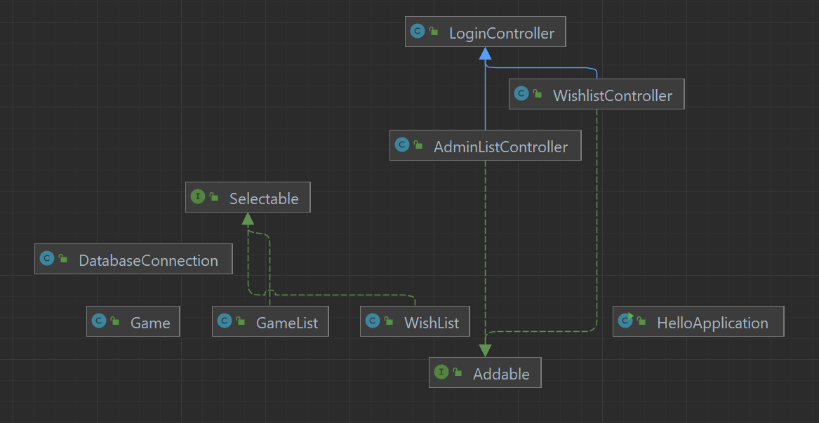

1)Create a diagram for your project which models the classes, interfaces and relationships between them. You must model at least 3 classes and 2 interfaces. You must use at least two collections (list, set, map, etc.).
Class Diagram Short
One for GameList class
One for WishList class

Slide 4
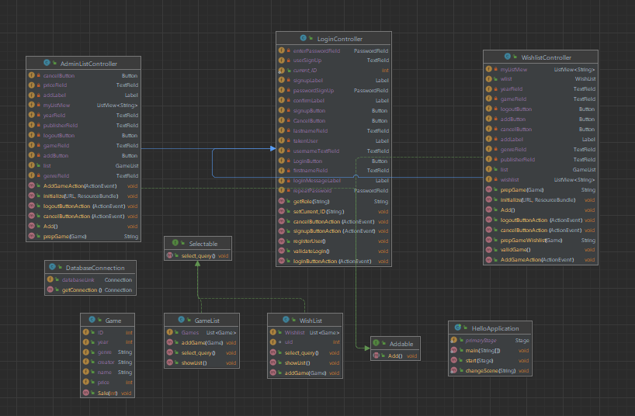
Class Diagram Extended

Slide 5
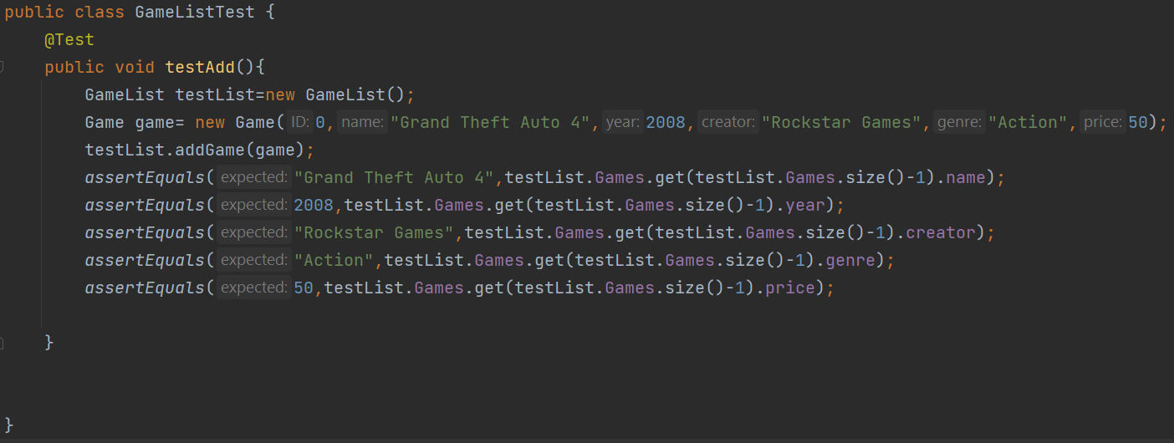
2) Create at least one test case (unit test) per class in your model
This task wasn’t hard after I figured out how to create tests for my classes

Slide 6
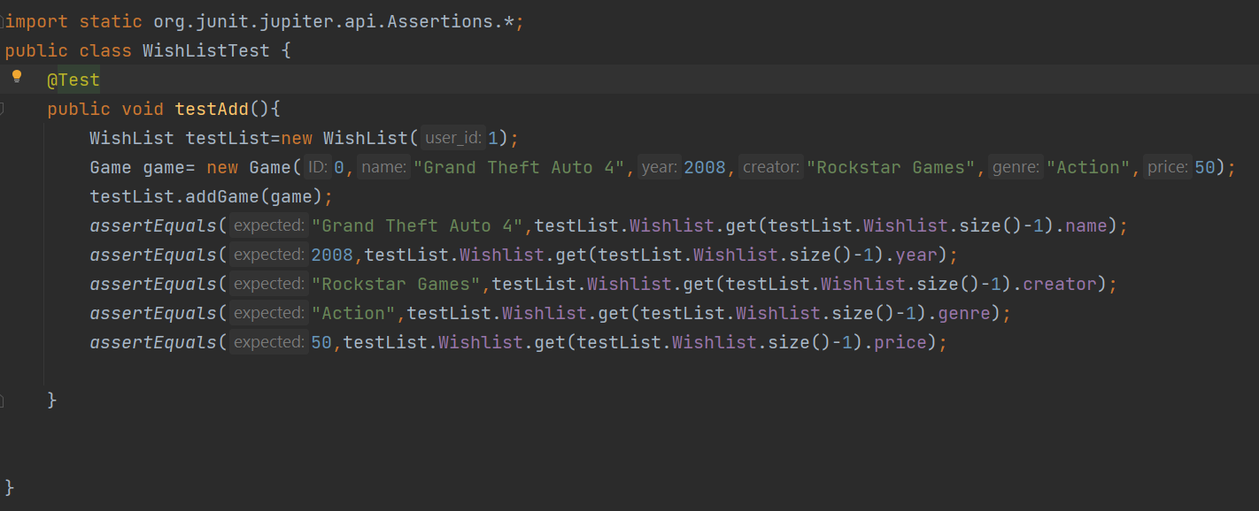
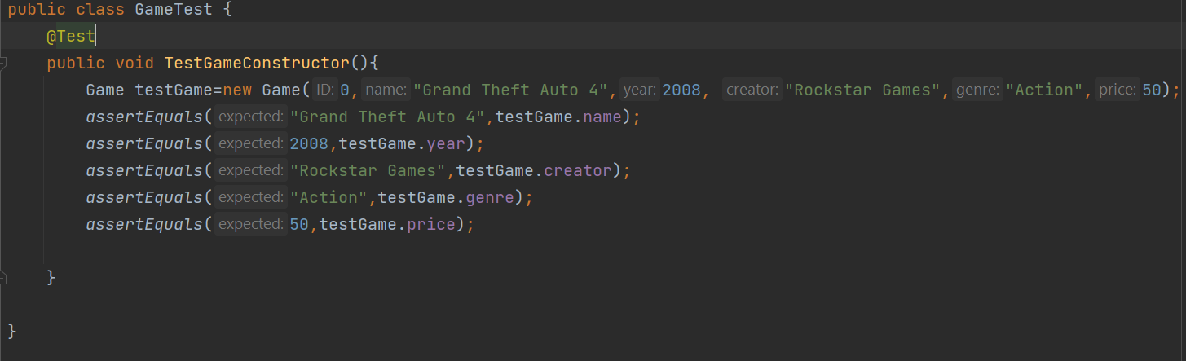

Slide 7
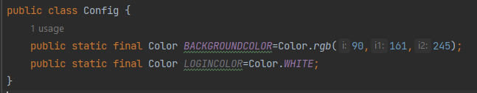
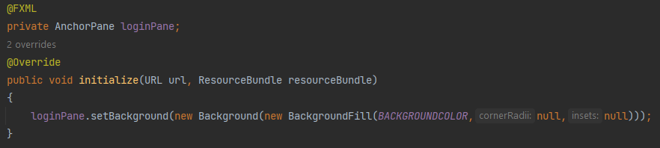
3) Use configuration files and/or program arguments to start the program in different ways
I use this to change the background of the logo in the login page
I declare this in the login controller

Slide 8
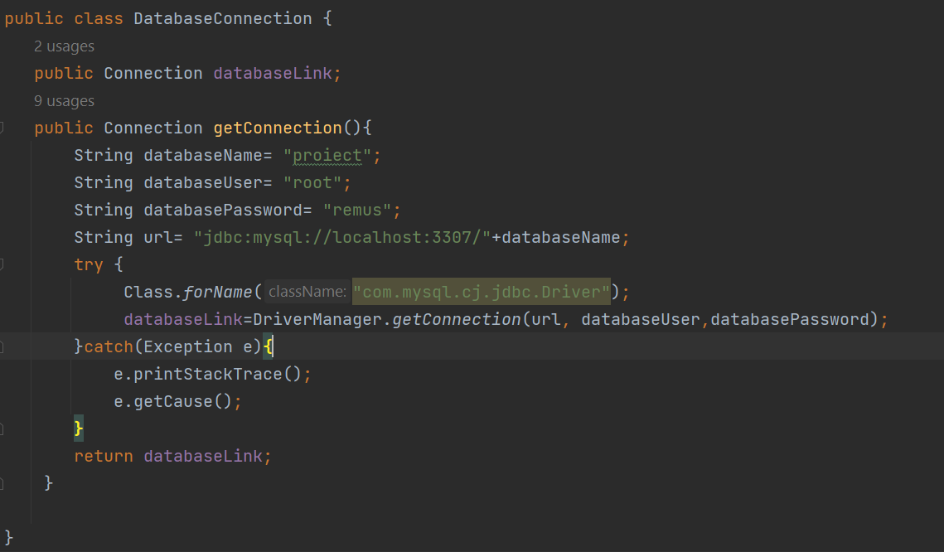
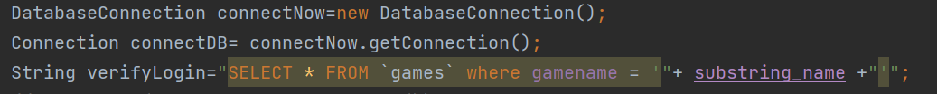
Database Connection 2) Create a connection with the database, query data and show it on screen (or UI).
I have a DatabaseConnection class to create the connection between my program and my database
This is how a connection is declared in my program

Slide 9
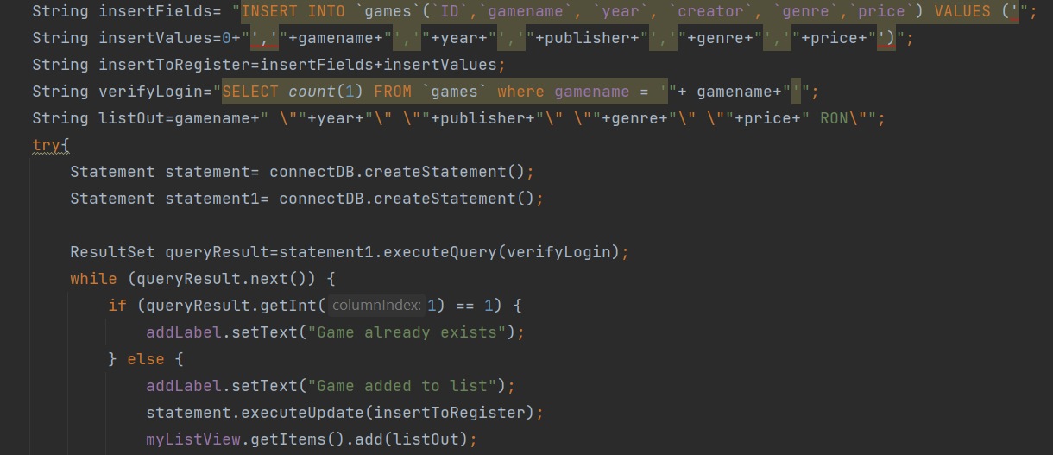
3) Insert or update data into the DB tables
An example of where I insert into the database is:
One of the difficulties I found in this task was getting the fields right for different databases

Slide 10
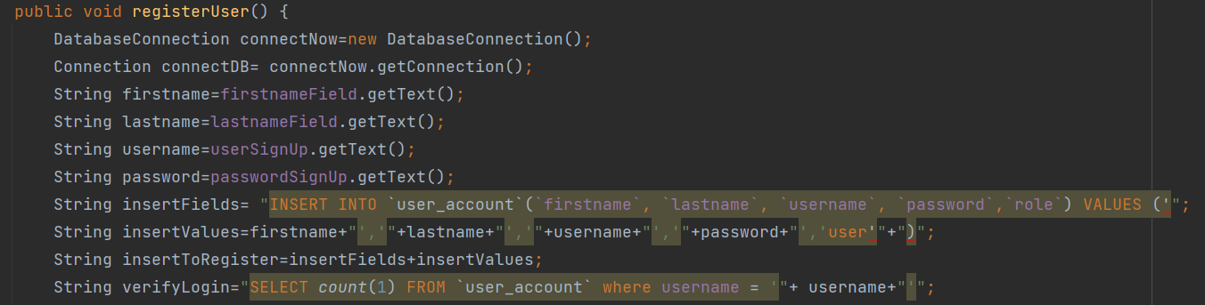
4) Manage users or roles for di↵erent access levels to the DB.
I have 2 roles in my DB: user, and admin, they both have access to different scenes and I differentiate them with the “role” column in my user_account table
The code above, is a user creation, an admin can only be created from the php_myadmin menu, any user I create from the program has the default role value of “user”

Slide 11
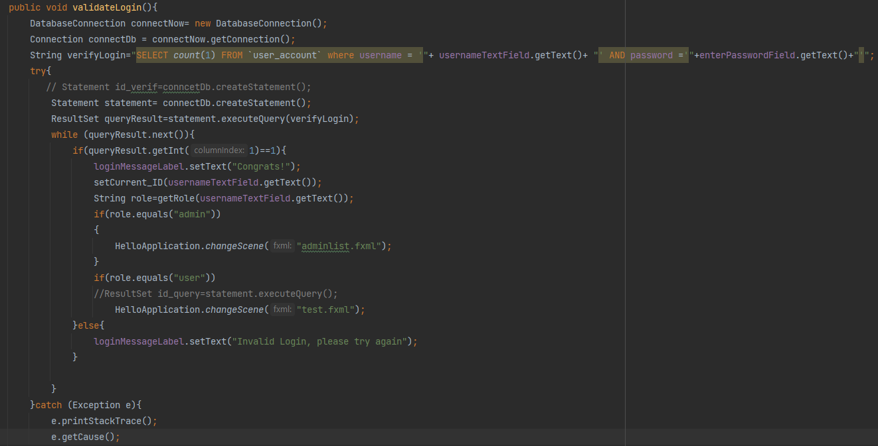
User interface 1) Validate input data before using it in your program (especially when interacting with the DB). All inputs must be validated. This does not mean you need to create a GUI, commandline-interfaces works also. By user interface we mean that a user can input data into the application
I validate the input in a lot of places but one example is where I login
If the account exists,and the info is correct it will redirect you to the specific scene

Slide 12
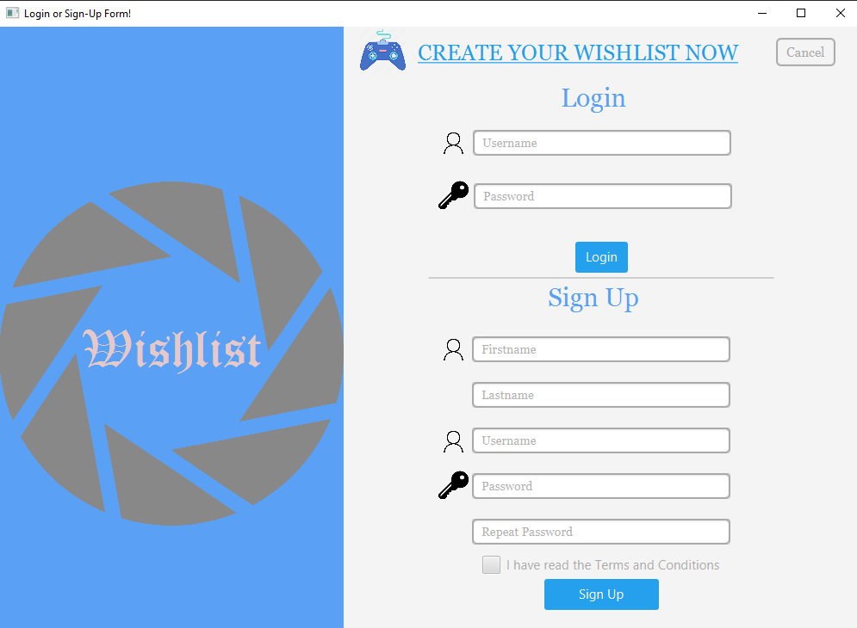
The Login Form:

Slide 13
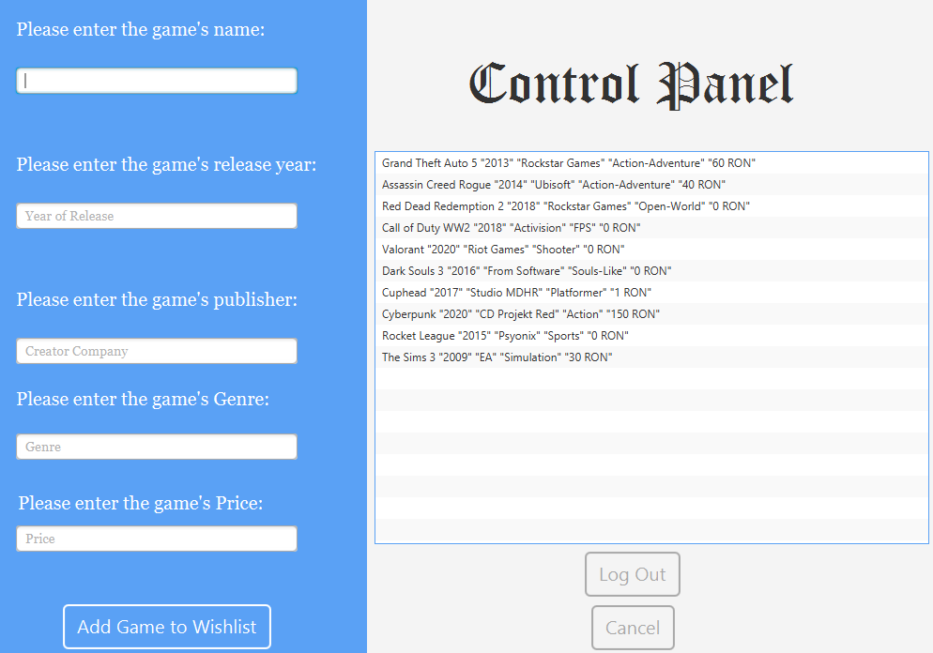
2) Create Scenes for your project. Each Scene must provide a di↵erent behavior for your project. Example: one scene for an admin that manages users, one scene for a user managing the stock, one scene for a client trying to buy from the stock. The stock can be any entities present in a database.
I have 2 scenes: Admin and User Scene

Slide 14
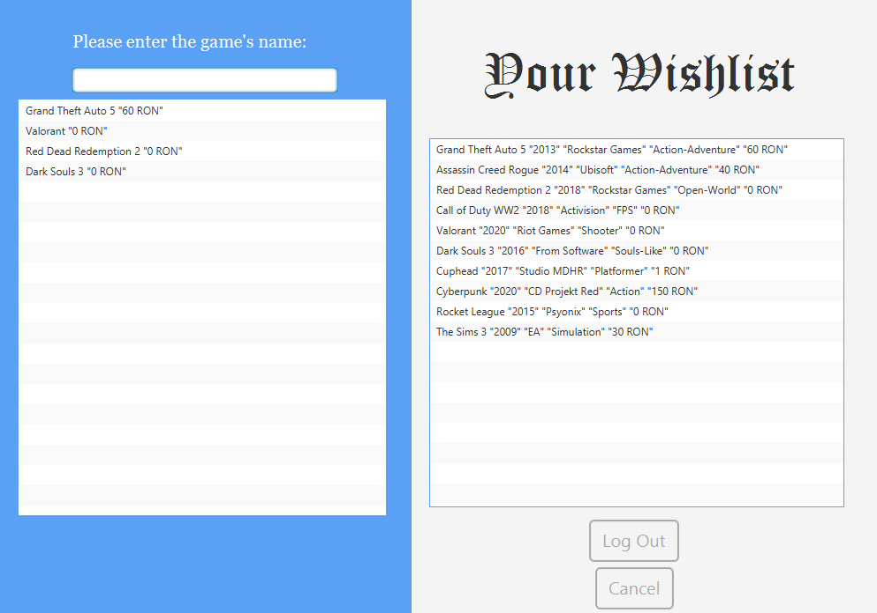
To complete this last task I needed to manage the roles of the database and redirect the user to different forms based on the account they enter in the login form and their privelleges

Slide 15
THANK YOU FOR YOUR ATTENTION

